Slide 1
Don’t be cheap. It’s too expensive !
Invest in your resources to maximize your return, and waste less

Slide 2
Common narrative
One of your employee leaves
Two weeks’ notice
The third one in less than 2 months
Having trouble filling in the position – salary is the issue
You can only afford junior employees

Slide 3
Common narrative
One of your more experienced employee will have to assume the responsibilities (taking their focus away from their own projects)
Your senior employee is dedicated, but not happy with the extra work, and the late nights it will require.
Team morale is taking a hit as they also have to pick up the work spillover

Slide 4
Common narrative – the revolving doors
Over the course of the months of this repetitive story
Your employee couldn't take the workload anymore
Couldn’t handle the pressure anymore
Burnout
Colleagues decide to leave as well, not to find themselves in the same position

Slide 5
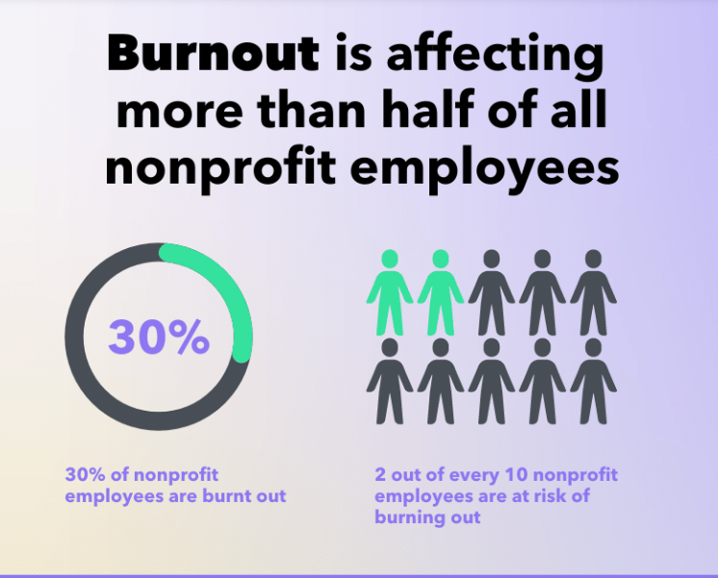

Slide 6
Common narrative
Our budgets are too tight
Salaries are not part of our mission
Don’t know where to cut spending
Cant’ we get a young recruit that we will train.
Enough with the shoestring mentallity !
“The nonprofit sector doesn’t have a problem with the education level, talent, creativity or ability of its workforce. What it has is an image problem and, in some cases, outdated leadership philosophies that thrive on a poverty mentality, leading to low compensation and a perceived lack of prestige surrounding positions in the sector.”
Tracy Vanderneck – Non Profit Pro, 2018.

Slide 7
Nonprofit sector
Charitable giving is on the rise
Unfortunately, so is nonprofit burnout
The nonprofit sector is made up of more than 1.8 million nonprofit organizations and employs more than 10% of the nation’s workforce (USA)
In fact, 30 percent of nonprofit employees are burnt out
20 percent are in danger of burning out
Source: survey conducted by Opportunity Knocks.

Slide 8
Nonprofit sector
Loosing key staff
voluntary turnover rate for nonprofit organizations is 19%
higher than the industry average of the overall labor market (12%)
Leaders (60% of nonprofit leaders) reported feeling “used up” at the end of the workday, according to DDI World’s Global Leadership Forecast for 2021.
Productivity gap in year 1 for new hire is 20%
Cost of staff turnover as a percentage of annual growth is 28%
Source: survey conducted by Opportunity Knocks.

Slide 9
Losing key staff - Is expensive
Cost of hiring a new person (advertising, interviewing, screening, hiring)
Cost of onboarding a new person (training, management time)
Lost productivity (a new person may take 1-2 years to reach the productivity of an existing person)
Lost engagement (other employees who see high turnover disengage and lose productivity)
Customer service and errors (new employees take longer and are often less adept at solving problems).
Training cost (over 2-3 years you likely invest 10-20% of an employee's salary or more in training, that is gone)
Cultural impact (whenever someone leaves others take time to ask "why?").
Source: https://www.linkedin.com/pulse/20130816200159-131079-employee-retention-now-a-big-issue-why-the-tide-has-turned/

Slide 10
Losing key staff - Is expensive
Cost of employer’s brand and reputation
High turnover could mean disgruntled ex-employees.
Engaged employees are willing to go the extra mile. High turnover at your organization can have the opposite effect on much of your staff.

Slide 11
Losing key staff - Expensive
Studies estimate that losing an employee can cost a company 1.5 to 2 times the employee’s salary (taking into consideration hiring, onboarding, training, ramp time to peak productivity, loss of engagement among other employees, etc.)
Keep in mind: people are what we call an "appreciating asset.
" The longer we stay with an organization the more productive we get - we learn the systems, we learn the products, and we learn how to work together.
Source: https://www.linkedin.com/pulse/20130816200159-131079-employee-retention-now-a-big-issue-why-the-tide-has-turned/

Slide 12
People don’t work for nonprofits to get rich.
That being said, employees need a living wage.
Givebutter Expert, Sherry Quam Taylor, weighs in:
"For decades, the nonprofit industry has been held to unrealistic expectations and outdated metrics that keep organizations from growing. The most insidious? “Nonprofits should be able to do more on less.” Not only are nonprofits supposed to change the world or solve huge crises, they’re expected to do it on shoestring budgets."

Slide 13
Change the paradigm

Slide 14
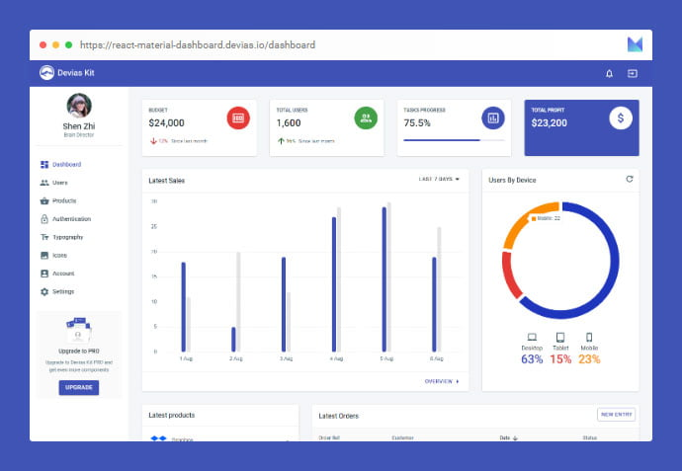
Change the paradigm Invest in your cause
Benchmark your nonprofit
Salaries offered
Various advantages
Work environment
Build a dashboard of Human Resources KPIs
Document your employee departures with complete exit interviews
Evaluate your losses annually (Cost of hiring, onboarding, training, etc.)

Slide 15
Change the paradigm Invest in your cause
Evaluate your payroll mass for investing in your team – and keeping them !
Salary / Experience / talents
New advantages
Performance bonus
Recognized employee seniority
Create development plans for your employees – customize, be creative

Slide 16
Educate your board of trustees Invest in your cause
Present your HR KPI (keep a detailed dashboard)
Present a benchmark of the competition
Demand a payroll mass that invests in the team:
Boost productivity
Better retention rate
Better moral
Just as retaining donors is cheaper and more valuable than finding new donors, keeping and retaining good employees is cheaper and more valuable than finding new ones.

Slide 17
Invest in your team for a greater return
Find the talent and skills you need – especially during a shortage of staff
Offer the proper salary – you will save in the long run
Offer a development plan
Provide a great employee experience
Foster a healthy work Environment

Slide 18
Invest in your team for a greater return
Attract better talent
Encourage learning
Ongoing training retains motivated employees
Keep communication channels open (360)
Keep your staff challenged and compensated properly
Engaged employees are committed

Slide 19
It costs much less to keep good employees
Than to replace them !

Slide 20
Good reads
How Leaders can Help Fundraisers avoid burnout
The great nonprofit leadership turnover
Shutting the revolving door of development turnover
Staff turnover: the 3 reasons fundraising professionals leave
Calculating the cost of losing high performing fundraisers
2019 Nonprofit Leadership impact study
How to mitigate the Nonprofit turnover rate problem
Community update: Staff, volunteer retention issues compounding sector pressure
Priorities and challenges for nonprofits in the first quarter of 2022
Nonprofit development staff turnover: is it a crisis or an old paradigm we need to change ?
Nonprofits staff retention, part1: are higher salaries really the answer ?
Nonprofit burnout statistics: the high cost of high turnover
Does the nonprofit industry have an employment problem ?
Nonprofit can pay more, why don’t they?

